Slide 1

Tata 1Mg Homeopathy Medicine Analysis

Slide 2
Introduction
Tata 1mg: India's top online healthcare platform offering medical services and products for diverse health needs.
This platform provides a vast range of medicines required for different categories in terms of price, rating, brands, etc.
Objectives
Analyzing the medicine data for consulting purposes.
Creating a interactive and user friendly dashboard which can show the results according to the filter applied by users.

Slide 3
Project Flow Chart
Web Scraping
Web Scraping using Beautiful Soup in python
Data Framing
Data Framing using Pandas
Data Cleaning
Data Cleaning using Python
Data Analysis
Data Analysis using Python , Power BI and SQL

Slide 4
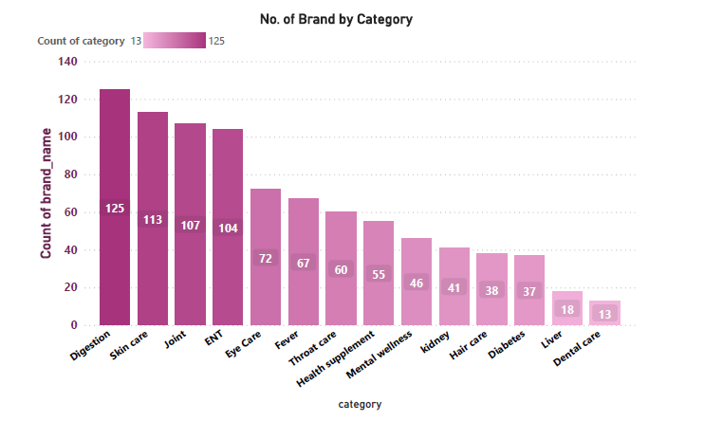
Number of medicines available for different categories
Medicine Availability Analysis
• Availability of medicines are higher in Digestion followed by Skin Care and Joint category.
• Lowest number of medicines in Dental Care, Liver and diabetes category.

Slide 5
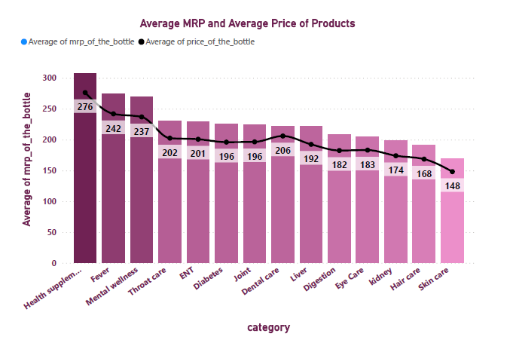
Price range of medicines for different category
Price Analysis

Slide 6
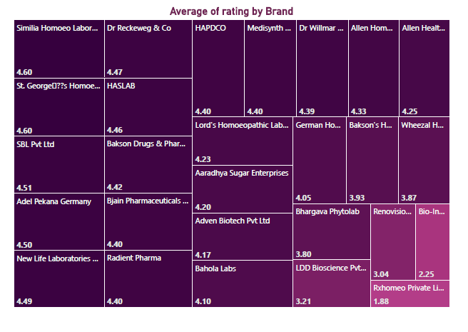
Average Rating of Different Brands
• Simlia Homeo and St. George has highest average rating(4.6) followed by SBL Pvt Ltd (4.51).
• Rx. Homeo has lowest average rating of 1.88.

Slide 7
Top Rated Brand Category Wise
Category | Brand | Top Rating
Dental care | Dr Reckeweg & Co | 4.7
Diabetes | Similia Homoeo Laboratory | 4.6
Digestion | Bjain Pharmaceuticals Pvt Ltd | 4.6
ENT | Adel Pekana Germany | 4.6
Eye Care | Wheezal Homeo Pharma | 4.6
Fever | HAPDCO | 4.6
Hair care | Adel Pekana Germany | 4.4
Health supplement | New Life Laboratories Pvt Ltd | 4.7
Joint | SBL Pvt Ltd | 4.6
kidney | Dr Willmar Schwabe India Pvt Ltd | 4.6
Liver | Dr Reckeweg & Co | 4.6
Mental wellness | Bakson's Homeopathy | 4.7
Skin care | HASLAB | 4.6
Throat care | Medisynth Chemicals Pvt Ltd | 4.7
• Table represents the top rated brands for different category.
• Minimum top rating is 4.4 whereas the maximum top rating is 4.7.

Slide 8
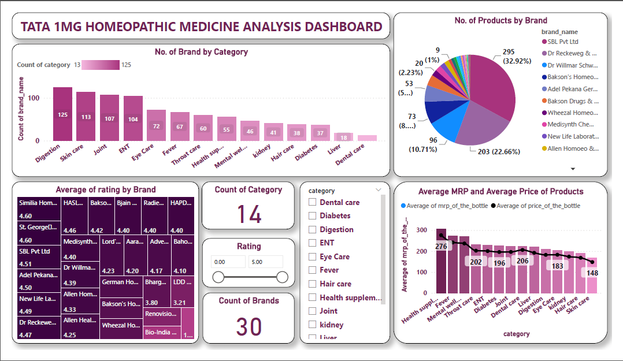
Dashboard

Slide 9
Insights
Digestion category has highest no. of brands providing the medicine which means demands in this category is very high.
Highest no. of products are being supplied by SBL. Pvt. Ltd. This means people have good faith in this brand.
Rating of SBL. Pvt. Ltd. is also good which is greater than 4.5.
Health Suppliment category has high MRP as well as high Selling price.
For category wise top rated brands, Dr Reckeweg & Co leads in more than 1 category.

Slide 10
Future Scope
Challenges faced
Access for data scraping blocked multiple times by server of website .
Data extraction of individual medicine by using its own URL makes process of web scraping more lengthy and time consuming.
High amount of Duplicate data extracted.
The above analysis can be used to generate a Machine Learning Model which can predict the price of medicine based on the key ingredients.

Slide 11
Thank You

